Slide 1
Regular Expression
Course Code:CSC3220
Course Title: Compiler Design
Dept. of Computer Science
Faculty of Science and Technology
Lecture No: | 07 | Week No: |  | Semester: | Fall: 23-24
Lecturer: | Shahnaj Parvin, sparvin@aiub.edu

Slide 2
Lecture Outline
Definition of a Regular Expression
Rules of a Regular Expression
Examples
Exercises

Slide 3
Objectives and Outcomes
Objectives:
Understand the basic concept of Regular expression
Understand the regular expression algorithm
Outcome:
Students should be able to design the nondeterministic finite automate from regular expression.
Students should be able to know the applications of a regular expression.

Slide 4
Regular Expression
Definition: A sequence of symbols and characters expressing a string or pattern to be searched for within a longer piece of text.
Another word to say a regular expression is a method used in programming for pattern matching. Regular expressions provide a flexible and concise means to match strings of text.
The regular expressions are built recursively out of smaller regular expressions, using some rules.
Each regular expression r denotes a language L(r), which is also defined recursively from the languages denoted by r ' s subexpressions.

Slide 5
Regular Expression
The regular expressions are built recursively out of smaller regular expressions, using some rules.
Each regular expression r denotes a language L(r), which is also defined recursively from the languages denoted by r ' s subexpressions.

Slide 6
Regular Expression
Design regular expressions for the following languages over {a, b}
Language accepting strings of length exactly 2
Language accepting strings of length atleast 2
Language accepting strings of length atmost 2

Slide 7
Rules of Regular Expression
Here are the rules that define the regular expressions over some alphabet £ and the languages that those expressions denote.
Basis
Induction
Precedence

Slide 8
Rules of Regular Expression
BASIS: There are two rules that form the basis:
E is a regular expression, and L(E) is {E}, that is, the language whose sole member is the empty string.
If a is a symbol in E, then a is a regular expression, and L(a) = {a}, that is, the language with one string, of length one, with a in its one position. Here italics is used for symbols, and boldface for their corresponding regular expression.

Slide 9
Rules of Regular Expression
INDUCTION: There are four parts to the induction. Suppose r and s are regular expressions denoting languages L(r) and L(s), respectively.
(r)|(s) is a regular expression denoting the language L(r) U L(s).
(r)(s) is a regular expression denoting the language L(r)L(s).
(r)* is a regular expression denoting (L(r))*.
(r)+ is a regular expression denoting (L(r))+.

Slide 10
Example of a Regular expression
Let E = {a, b}.
1. The regular expression a|b denotes the language {a, b}.
2. (a|b)(a|b) denotes {aa, ab, ba, bb}, the language of all strings of length two over the alphabet E.
Another regular expression for the same language is aa|ab|ba|bb.
3. a* denotes the language consisting of all strings of zero or more a's, that is, {ε, a , a a , a a a , . . . }.

Slide 11
Example of a Regular expression
Let E = {a, b}.
4. (a|b)* denotes the set of all strings consisting of zero or more instances of a or b, that is, all strings of a's and b's: {ε, a, b, aa, ab, ba, bb, aaa,...}.
Another regular expression for the same language is (a*b*)*.
a|a*b denotes the language {a, b, ab, aab, aaab,...}, that is, the string a and all strings consisting of zero or more a's and ending in b.

Slide 12
Operations of a Regular expression
Operations:
The various operations on languages are:
Union of two languages L and M is written as
L U M = {s | s is in L or s is in M}
Concatenation of two languages L and M is written as
LM = {st | s is in L and t is in M}
The Kleene Closure of a language L is written as
L* = Zero or more occurrences of language L.
The positive closure of a language L is written as
L+ = One or more occurrences of Language L

Slide 13
εR=R ε=R
ε*= ε ε is null string
(Φ)*= ε Φ is empty string
ΦR=R Φ= Φ
Φ+R=R
R+R=R
RR*=R*R=R+
(R*)*=R*
Ε+RR*=R*
(P+Q)R=PR+QR
(P+Q)*=(P*Q*)*=(P*+Q*)*
R*(ε+R)=( ε+R)R*=R*
(R+ε)*=R*
Ε+R*=R*
(PQ)*P=P(QP)*
R*R+R=R*R
Identities of regular expression

Slide 14
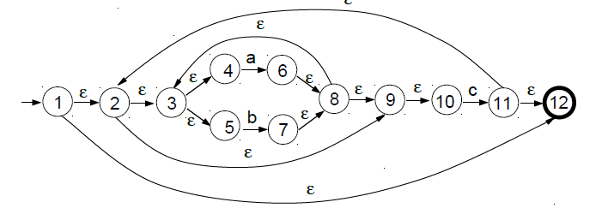
Regular Expression To NFA
Outline the NFA generated by the construction of Thompson relevant to the following regular expression:
Example: ((a | b)*c)*

Slide 15
Regular Expression To NFA
By means of the construction of Thompson, outline the NFA relevant to the following regular expression:
Example: a (b | c)*d

Slide 16
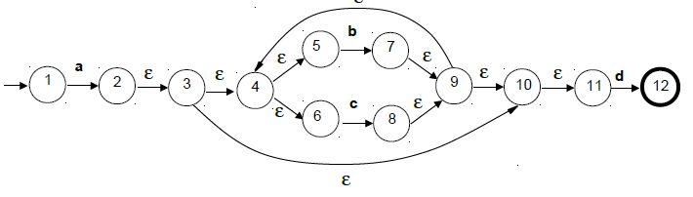
Regular Expression To NFA
By means of the construction of Thompson, outline the NFA relevant to the following regular expression:
Example: a (b | c)*d

Slide 17
Class Exercises
(aUb)*abc
2. (abUbc(abUc)*)*

Slide 18
Lecture References
A. Aho, R. Sethi and J. Ullman, Compilers: Principles, Techniques and Tools
(The Dragon Book), [ Second Edition]

Slide 19
References
A. Aho, R. Sethi and J. Ullman, Compilers: Principles, Techniques and Tools(The Dragon Book), [ Second Edition]
Principles of Compiler Design (2nd Revised Edition 2009) A. A. Puntambekar
Basics of Compiler Design Torben Mogensen

